Slide 1
topicSeven
HTML Tables

Slide 2
Learning Objectives
At the end of this chapter the students should be able to:
Understand table format, elements, attributes, width and height.
Use colspan and rowspan.
Manipulate table to design the web page

Slide 3
Introduction
Tables are used on websites for two major purposes.
The obvious purpose of arranging information in a table whiles the less obvious but more widely used is for the purpose of creating a page layout with the use of hidden tables.
Using tables to divide the page into different sections is an extremely powerful tool.
Almost all major sites on the web are using invisible tables to layout the pages

Slide 4
Introduction
The most important layout aspects that can be done with tables are:
Dividing the page into separate sections:
An invisible table is excellent for this purpose.
Creating menus:
Typically with one color for the header and another for the links following in the next lines.
Adding interactive form fields:
Typically a gray area containing a search option.
Creating fast loading headers for the page:
A colored table with a text on it loads like a bullet compared to even a small banner.
Easy alignment of images that have been cut into smaller pieces.
A simple way to allow text to be written in two or more columns next to each other.

Slide 5
Introduction
The importance of using tables for these layout purposes can't be overrated.
However there are a few things to keep in mind when doing so.
Most important is, that the content of a table is not shown until the entire table is loaded.
If you have extremely long pages, you should divide it into two or more tables thus allowing the user to start reading the upper content while the rest of the page is loading

Slide 6
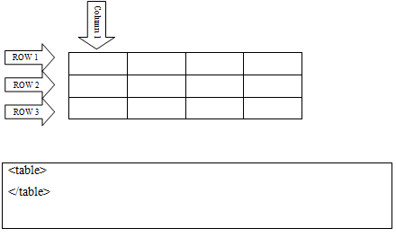
Creating Simple Table
Tables are defined with the <table> tag.
It consists of row and column.
To insert a table on your page you simply add these tags where you want the table to occur:

Slide 7
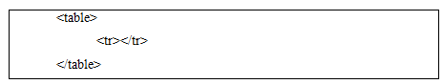
Inserting Row
To add rows to your table use the <tr> and </tr> tags.
It doesn't make sense to write the above lines in itself, because you can't write content outside of table cells.
If you do write things outside of cells it will appear right above the table

Slide 8
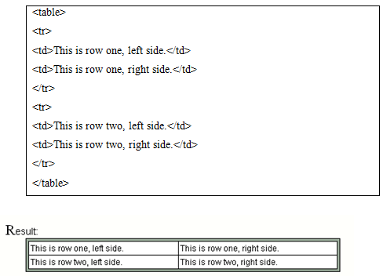
Inserting Column
You can divide rows into columns with <td> and </td> tags:

Slide 9
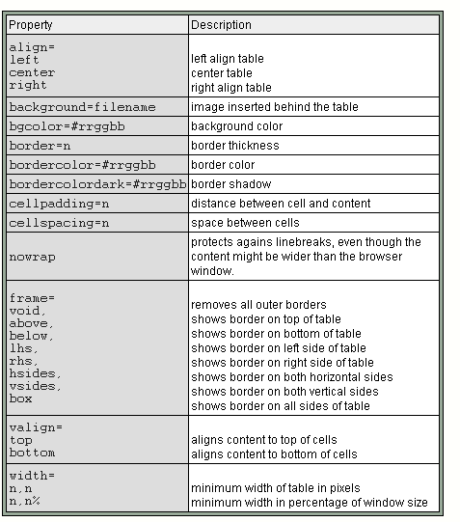

Slide 10
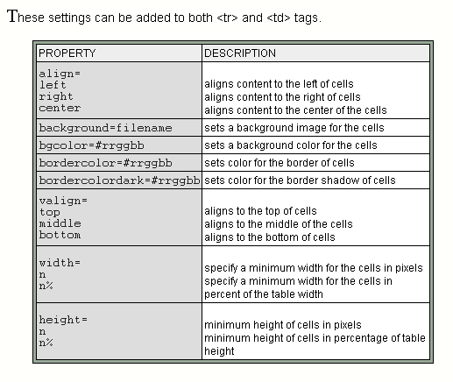

Slide 11
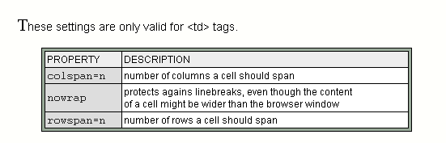

Slide 12
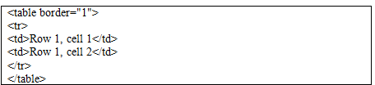
Adding a Border
If you do not specify a border attribute, the table will be displayed without borders.
Sometimes this can be useful, but most of the time, we want the borders to show.
To display a table with borders, specify the border attribute:

Slide 13
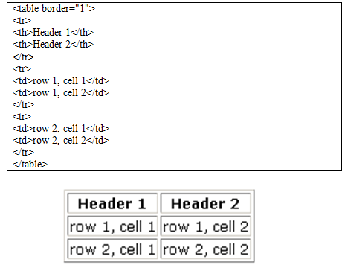
Header information in a table is defined with the <th> tag. All major browsers will display the text in the <th> element as bold and centered.

Slide 14
Setting the Width
The width attribute specifies the width of a table.
If the width attribute is not set, a table takes up the space it needs to display the table data.
It can be either in pixel or percentage.
To display a table with specified width, specify the width attribute

Slide 15
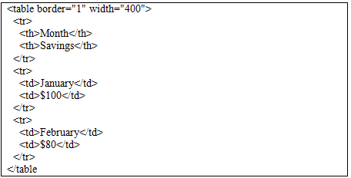

Slide 16
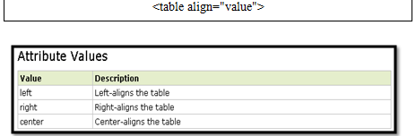
Centering a Table on the Page
The align attribute specifies the alignment of a table according to surrounding text.
Normally, an HTML table will have a break before and after it.
The align attribute allows other HTML elements to wrap around the table.

Slide 17
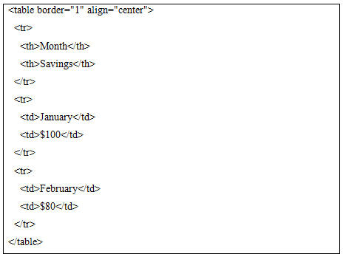

Slide 18
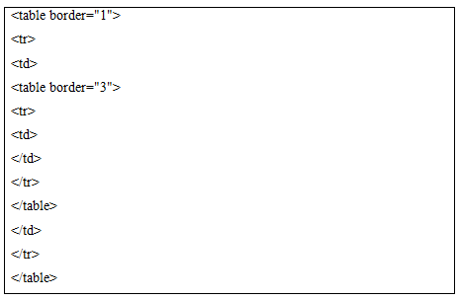
Combining Tables
Several tables can be combined together to create a more systematic page arrangement.
Its likes creating a table in a table:

Slide 19
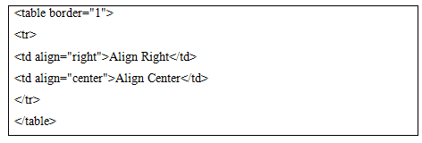
Aligning a Cell’s Contents
To align cell contents, we must used align attribute within the <td> tags

Slide 20
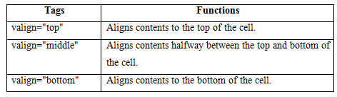
Aligning a Cell’s Contents
You can also use another alignment command for your cells, the vertical alignment command.
The vertical alignment commands come in useful if your table cells don't have the same number of lines inside each cell.

Slide 21
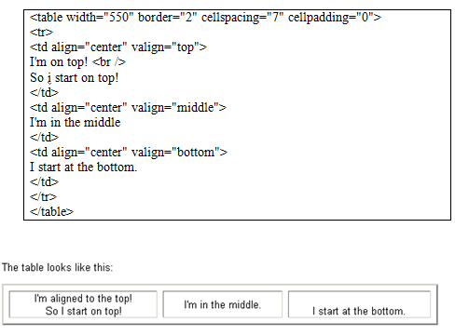

Slide 22
Changing the Background
Background is a nonstandard attribute supported by Netscape Navigator (NN), Microsoft Internet Explorer (MSIE), and Web TV.
The value is the URL of the background image.
If the image dimensions are smaller than the table dimensions and there is enough space in the table, the image will tile.

Slide 23
Changing the Background
Browsers vary in handling table backgrounds.
The results will not always be what you had anticipated.
MSIE places background images behind the entire table.
Netscape Navigator 4.x tries to place the background image into each table cell.
If BACKGROUND and BGCOLOR are both coded with appropriate values the BACKGROUND will take precedence if the image can load.

Slide 24
Changing the Background
If for some reason the image fails to load, the browser will use the value of BGCOLOR.
You must not to get carried away with background images in tables.
Rarely are they effective and download time increases with the use of images.
Sometimes users will not wait for images to download

Slide 25
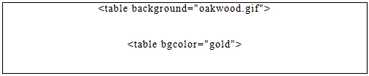
Changing the Background
If you have to code BACKGROUND for a table try to use a very subtle image, such as a watermark.
Tables with background images are often difficult to read.

Slide 26
Controlling the Space
The space in the table can be control using the cellpadding and cellspacing attribute.
Think of cellpadding as the width of the inside cell borders for the table cells.
It is an attribute of the <table> element which is set for the entire table in the table tag.
Cellspacing, on the other hand, refers to how space is left between each cell wall in a table.
If you want no spaces at all, you MUST set cellspacing="0", otherwise the default is cellspacing="1", even if you don't even mention cellspacing

Slide 27
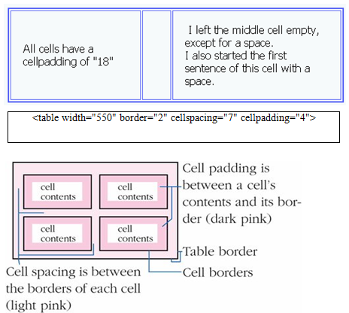

Slide 28
Spanning a Cell across Columns and Rows
These two features, Colspan and Rowspan, allow you to extend columns and rows across multiple other columns and rows when they would usually be forced to stop.
In this section you will learn how to extend columns and rows.

Slide 29
Colspan
Column Span extends cells on a horizontal row (left and right).
The line to add for Column Span is colspan="X".
This line adds onto the <td> cell so the final result would look like this
<td colspan="x">.
The "X" in the line, is replaced with the number of cells it extends past.
So for example, if it is covering the distance that of 3 cells above or below it, the line would look like <td colspan="3">

Slide 30
Rowspan
Row Span meanwhile extends cells on a vertical row (up and down).
The line to add for Row Span is rowspan="x".
This line adds onto the <td> cell so the final result would look like this
<td rowspan="x">.
The "X" in the line, is replaced with the number of cells it extends.
So for example, if it is covering the distance that of 3 cells left or right of it, the line would look like <td rowspan="3">.

Slide 31
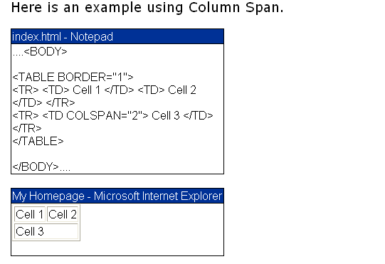

Slide 32
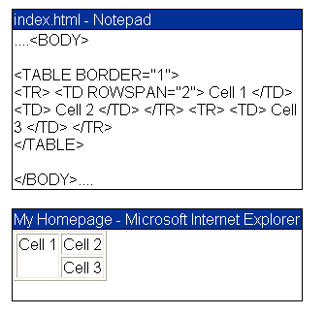

Slide 33
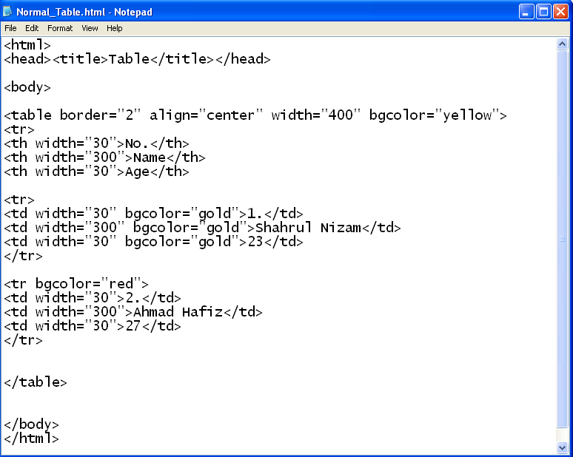
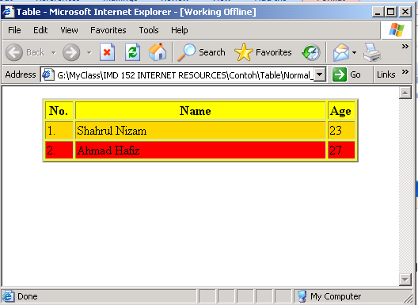

Slide 34
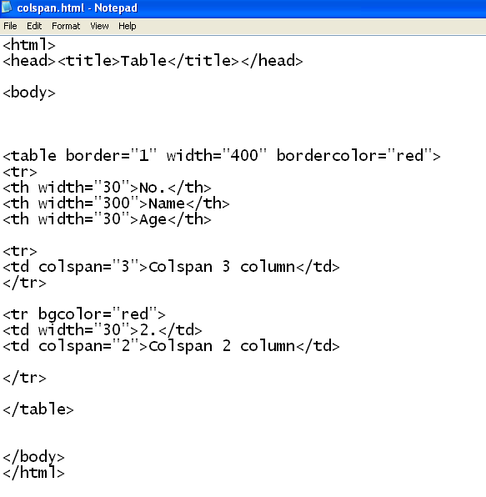
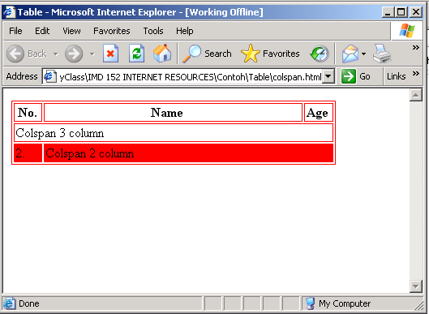

Slide 35
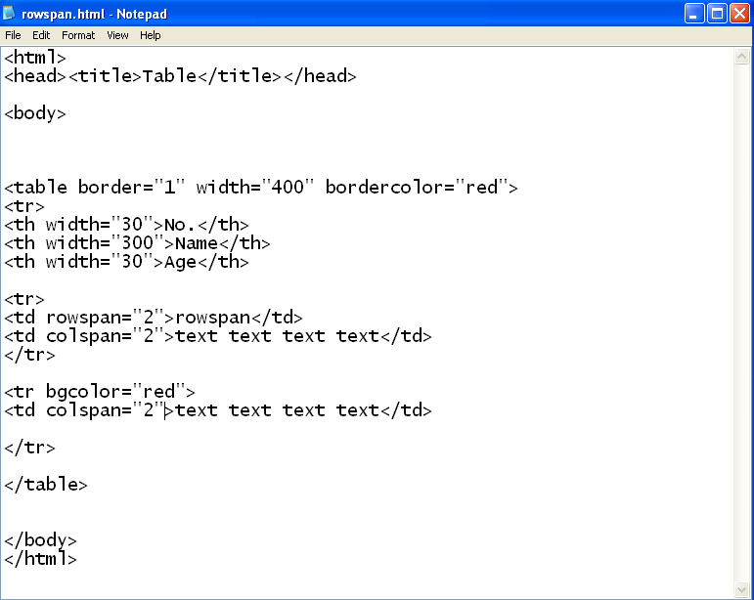
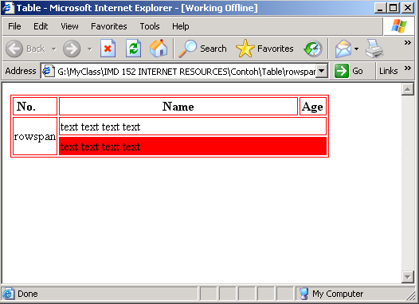

Slide 36
Mapping Out Your Page
Before you create a complicated table, it's really important to have a vision of what you're about to construct.
You should know how many rows and columns you need, how big these should be, and where each of the items on your page should go.

Slide 37
To map out your page:
Design your page on a piece of paper with a pen
Figure out how many rows and columns you will need. Identify any rows or columns that will span more than one space.
If necessary, you can nest one table inside another. However, you should keep nesting to a minimum as it tends to slow browsers download sometimes causes them to break down altogether.
If you're going to make a static, fixed design, measure how wide your table should be (the standard is around 600 pixels) and then decide how many pixels wide each column should be. For liquid designs, use percentages.
Create the skeleton of your page with just the table tags but little or no content.
Finally, create or insert the content.

Slide 38
